Slide 1
Spooky SQL Carnival
PASS Speaker Idol 2019
William Assaf

Slide 2
Agenda of Terror
HORRIFYING nonsequential newsequentialid() GUIDs
SHOCKING foreign key behavior
TERRIFYING duplicate primary keys

Slide 3
Carnival of SQL Spookyness
Scary, frightening database sights!
Proceed only if you dare! We are not responsible for any injuries resulting from previously existing medical conditions.
Features of night, brought to light!

Slide 4
Fright #1
Proceed only if you dare, and have never thought that using newsequentialid() is a good idea!
Behold, the terror of the newsequentialid()!

Slide 5
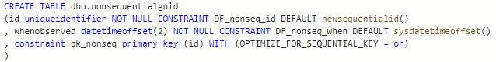
Nonsequential newsequentialid()
To set the stage we create a table with a uniqueidentifier column as the primary key and clustered index, using the newsequentialid() function as a default.

Slide 6
Nonsequential newsequentialid()
Ran some inserts, caused some things to happen, and then…

Slide 7
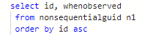

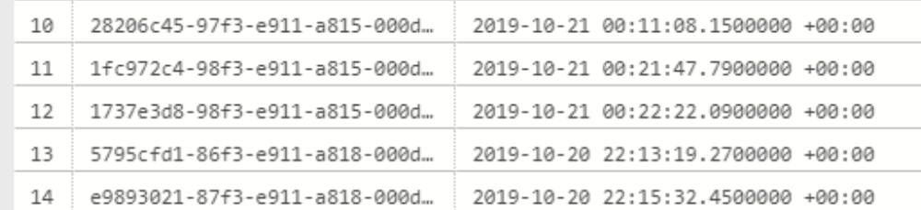
Nonsequential newsequentialid()
Released free for commercial use. https://pixabay.com/illustrations/cartoon-skeleton-character-906074/

Slide 8
INSERT SORT ORDER
Expected behavior
of newsequentialid()
Actual behavior
when seed changes
Server change!
Server change!
Server change!
Server change!
Server change!
Server change!
Server change!
No Fragmentation
Fragmentation Upon Insertion

Slide 9
HowTo: Nonsequential sequential GUID
Failover to another machine in FC or AG
Upgrade or Migrate to new hardware
Upgrade or Migrate to new platform
Change the tier of Azure SQL DB
Reimage an Azure VM with ephemeral OS
Any change to SQL Server’s NIC’s MAC

Slide 10
HowTo: Nonsequential sequential GUID
The C++ function UuidCreateSequential is based on the MAC address of the NIC.
"Therefore you should never use this UUID to identify an object that is not strictly local to your computer.“
Which may rule out any High Availability or portability! Scary!

Slide 11
Fright #2
Proceed only if you dare, and have never thought that foreign keys were magical! Behold, the shocking truths behind foreign keys!

Slide 12
Foreign Keys Check
You might just think SSMS is pranking you with this extra CHECK business
ALTER TABLE [dbo].[table2] ADD CONSTRAINT [FK_table2_table1] FOREIGN KEY([table1id]) REFERENCES [dbo].[table1] ([id])
GO
ALTER TABLE [dbo].[table2] CHECK CONSTRAINT [FK_table2_table1] --This doesn't re-trust the FK!
GO

Slide 13
Fright #3
Proceed only if you dare, and have ever thought the float data type was trustworthy! Behold, duplicate primary key horror!

Slide 14
Float as PK
Many businesses have an invoice or lineitem system that looks like this:
YearNumberNumber.lineitem
Which ends up looking like a number like this, for example:
2019000000000.001
2019000000000.002
2019000000000.003…

Slide 15
Float as PK
Many businesses have an invoice or lineitem system that looks like this:
YearNumInvoiceNum.LineItemNum
Which ends up looking like a number like this, for example:
2019000000000.001
2019000000000.002
2019000000000.003…

Slide 16
Float as PK
lab- float as pk problems.sql

Slide 17
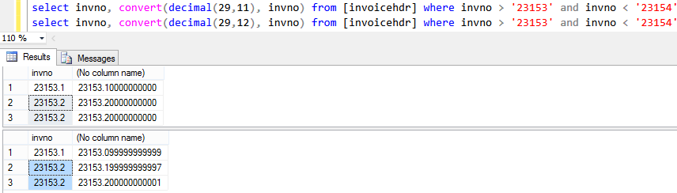
Float as PK
Converting float to decimal can be problematic!
Released free for commercial use. https://pixabay.com/illustrations/cartoon-skeleton-character-906074/

Slide 18
Float as PK
Float is a floating point number.
Approximate numeric data types do not store the exact values specified for many numbers; they store an extremely close approximation of the value, rounding up in Microsoft SQL Server.

Slide 19
Float as PK
You should only use float if the max precision of decimal (38 digits!) is insufficient.
Further warnings from Microsoft Docs:
“Avoid using float or real columns in WHERE clause search conditions, especially the = and <> operators.”

Slide 20
Thanks for your time!
Hopefully you are all not too scared to enjoy the rest of PASS Summit 2019!

